Slide 1



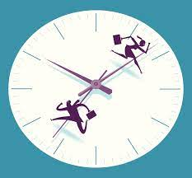

Preparation Phase vs Execution Phase

